Slide 1

Artificial Intelligence Project
Weapon Detection System
Team Members :
Abhishek Singh (RA2011026010098)
Vishvesh Bhardwaj (RA2011026010109)
Raghav Kapoor (RA2011026010117)

Slide 2



Social Benefits
´The weapon detection system using machine learning has several potential benefits for society.
Firstly, it can enhance security in public places, reducing the risk of mass shootings and other firearm-related incidents.
Secondly, it can provide security personnel with real-time information about potential threats, enabling them to respond quickly and effectively.
Thirdly, it can save time and resources by automating the firearm detection process, reducing the need for manual screening of individuals.
Finally, it can provide peace of mind to the general public, knowing that measures are in place to ensure their safety in public places.

Slide 3

Problem Statement
The increasing instances of mass shootings in public places have highlighted the need for improved security measures to prevent such incidents.
Traditional security measures, such as metal detectors, are not always effective as they can be evaded by using non-metallic weapons.
Additionally, manually screening every person entering a public space is time-consuming and impractical.
Therefore, there is a need for an automated system that can detect firearms in real-time, providing security personnel with the information necessary to respond to any potential threat.

Slide 4
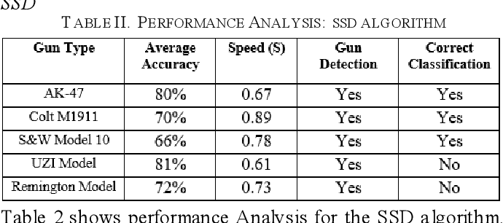
LITERATURE SURVEY

Slide 5
The objectives with Technical depth
The objective of a weapon (gun) detection system using machine learning (ML) is to develop a system that can accurately and reliably detect the presence of firearms in real-time using video or image feeds. This system can be used to enhance public safety in areas such as schools, airports, government buildings, and other high-risk areas.
Technically, the system should be designed to analyze visual data (images or videos) using deep learning algorithms, which are a subset of ML algorithms. The system should be trained on large datasets of firearms and non-firearms images to learn the distinguishing features of firearms. These features may include the shape, size, color, and texture of firearms, as well as the context in which they appear.

Slide 6
The objectives with Technical depth
The system should also be able to handle various real-world challenges, such as changes in lighting conditions, occlusions, and different camera angles. Therefore, the system may need to be equipped with advanced image processing techniques, such as background subtraction, edge detection, and object tracking, to help it distinguish between firearms and other objects.
Once the system has detected the presence of a firearm, it should be able to send alerts to security personnel or law enforcement agencies, enabling them to take appropriate action. The system should also be designed to continuously learn and improve its accuracy over time through ongoing training with new datasets.

Slide 7

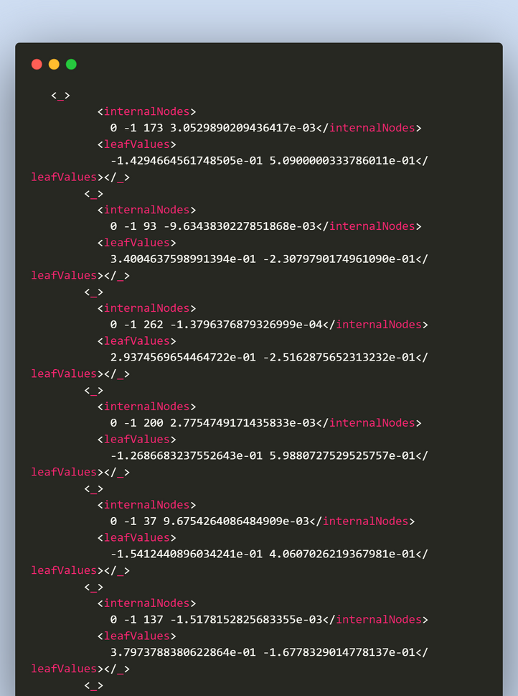
DATASET

Slide 8


MODULES
01
Login Window Module
02
Detection Module
03
Detection Window Module
04
Settings Module
05
Main Module

Slide 9
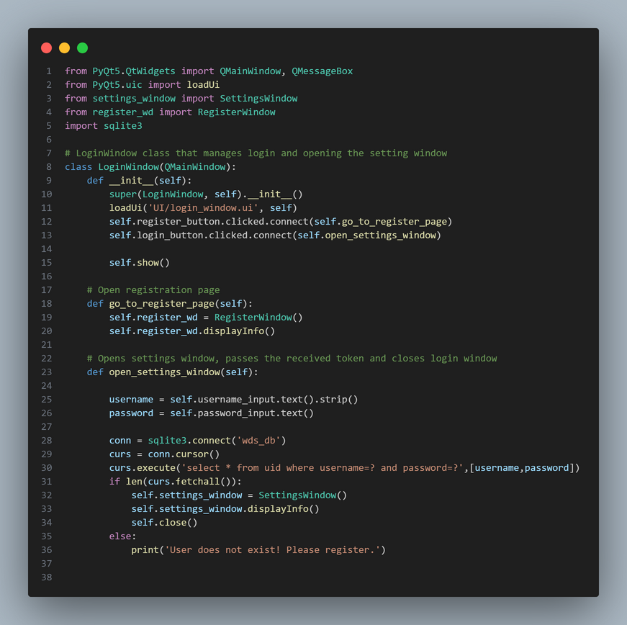
LOGIN WINDOW MODULE CODE

Slide 10

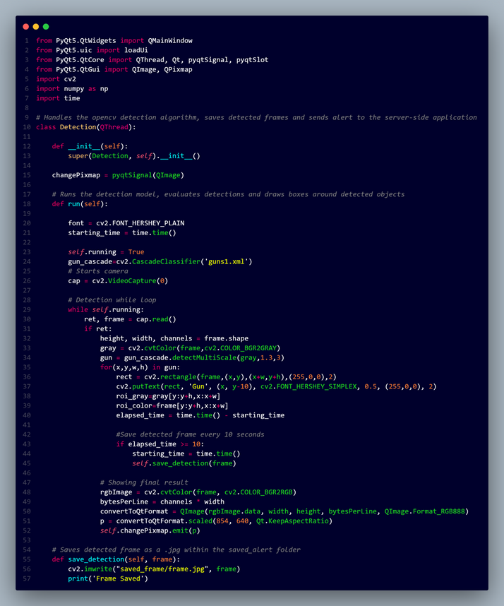
DETECTION MODULE CODE

Slide 11

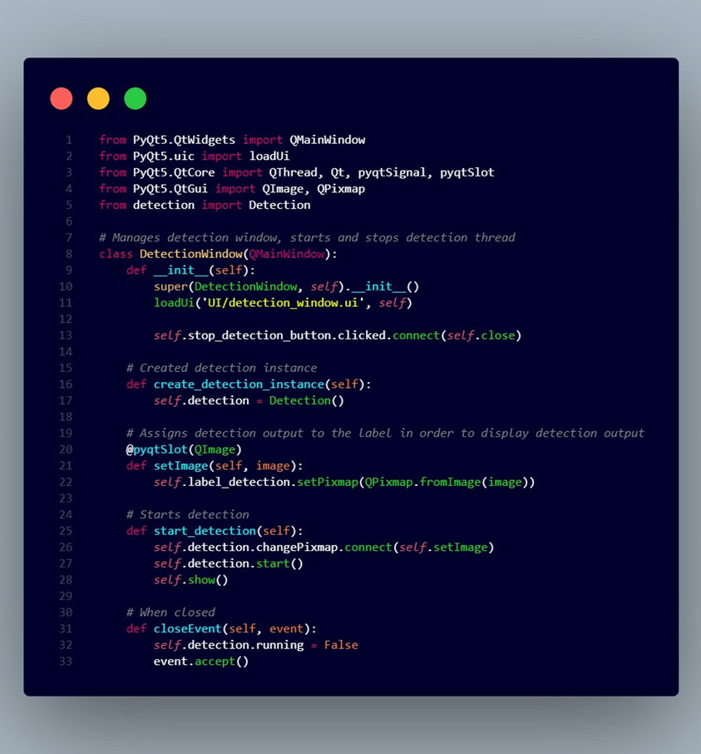
DETECTION WINDOW MODULE CODE

Slide 12
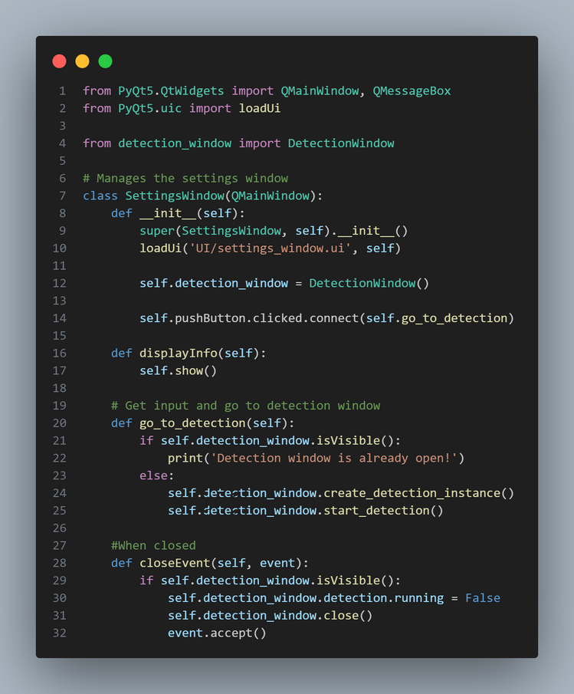
SETTING WINDOW MODULE CODE

Slide 13

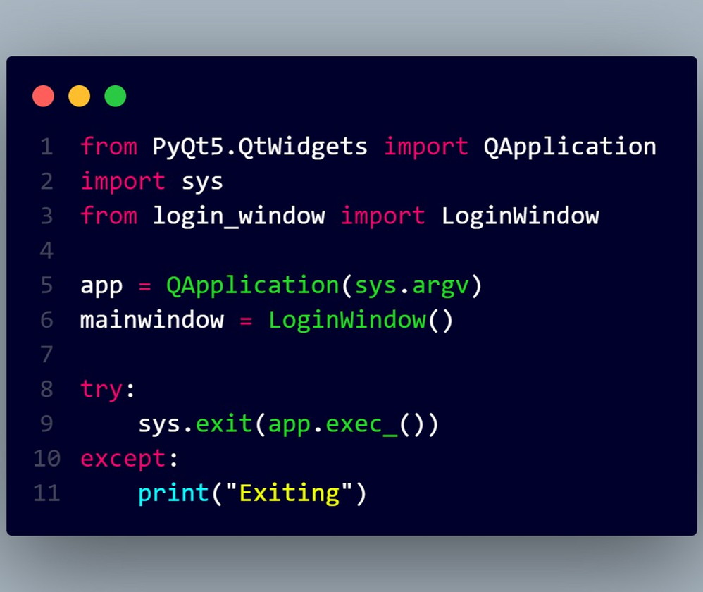
MAIN MODULE CODE

Slide 14

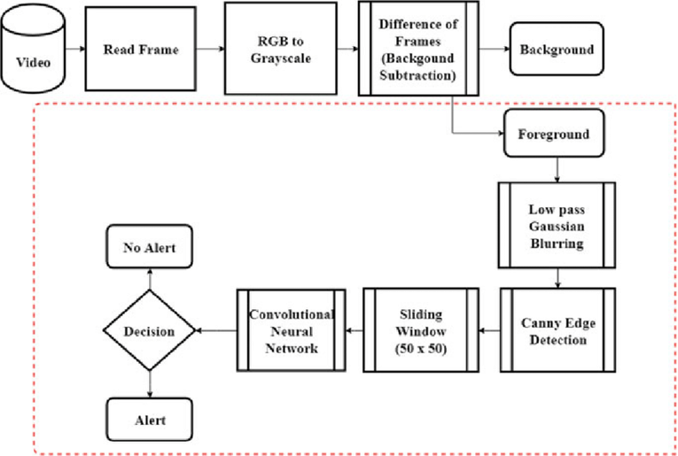
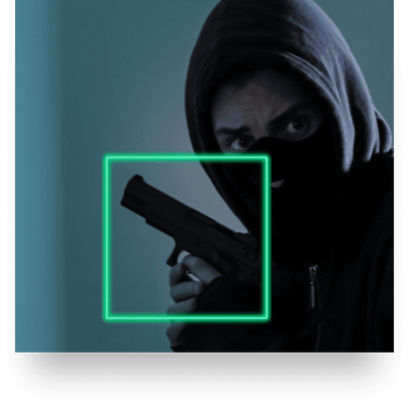
ALGORITHM
YOLOv4 (You Only Look Once Version 3) is a real - time object detection algorithm that identifies specific objects in videos, live feeds, or images.

Slide 15
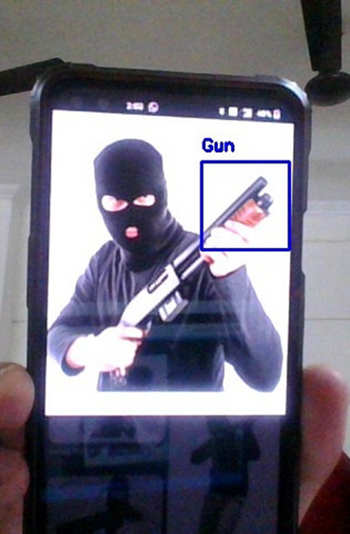
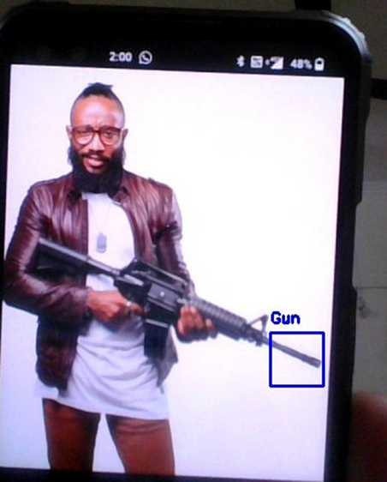
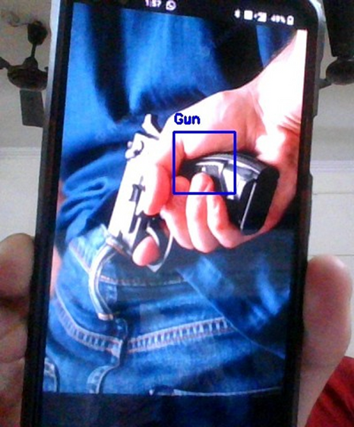
DETECTION WINDOW IMPLEMENTATION

Slide 16
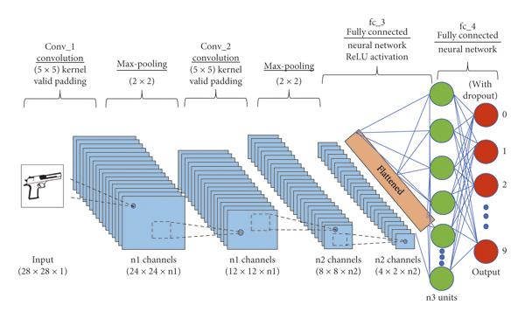
FLOW DIAGRAM

Slide 17


RESULT AND CONCLUSION
In this era where things are automated, object detection becomes one of the most interesting field. When it comes to object detection in surveillance systems, speed plays an important role for locating an object quickly and alerting theauthority. This work tried to achieve the same and its able to produce a faster result compared to the previously existing systems.

Slide 18
GITHUB LINKS
ABHISHEK SINGH : https://github.com/AbhishekSingh1247/Weapon-Detection-System
VISHVESH BHARDWAJ : https://github.com/Vishvesh-Bhardwaj/Weapon-Detection-System
RAGHAV KAPOOR : https://github.com/Kraghav2002/Weapon-Detection-System

Slide 19

THANKYOU

